Slide 1
Persistence: I/O Devices
Dr. Probir Roy
Some slides are modified from
* Dr. Shengquan Wang
Operating Systems: Three Easy Pieces, by Remzi H. Arpaci-Dusseau and Andrea C. Arpaci-Dusseau
Operating System Concepts, 8th edition, by Silberschatz, Galvin, Gagne, John Wiley & Sons, 2009
Notes:
1

Slide 2
Outline
System architecture
Notes:
2

Slide 3
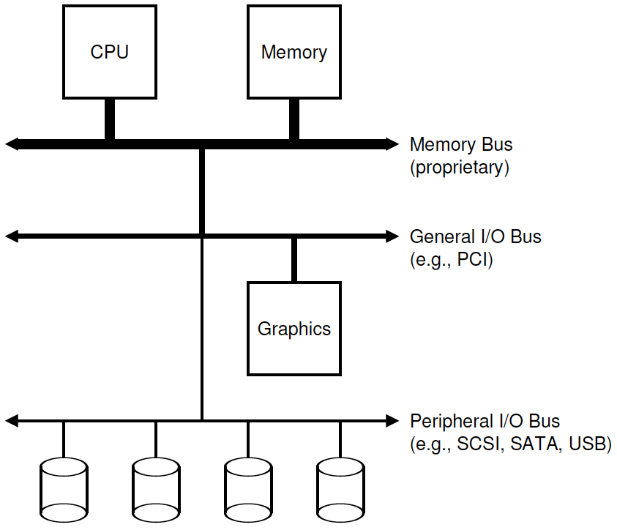
Prototypical system architecture
CPU attached to the main memory.
Graphics and some other higher-performance I/O devices.
The slowest devices including disks, mice, and other similar components.

Slide 4
Why such kind of design?
high performance components (such as the graphics card) are nearer the CPU;
lower performance components are further away.
Physics:
The faster a bus is, the shorter it must be;
Thus, a high-performance memory bus does not have much room to plug devices and such into it.
Cost:
Engineering a bus for high performance is quite costly.

Slide 5
Modern System Architecture

Slide 6
Persistence
In system memory, data can be easily lost, as devices such as DRAM store values in a volatile manner
when power goes away or the system crashes, any data in memory is lost.
Thus, we need hardware and software to be able to store data persistently
such storage is thus critical to any system as users care a great deal about their data.

Slide 7
Hardware and software supports
Hardware
It comes in the form of some kind of input/output (I/O) device.
A hard drive is a common repository for long-lived information.
Software
The software in the OS that usually manages the disk is called the file system.
It is responsible for storing any files the user creates in a reliable and efficient manner on the disks of the system.

Slide 8
Uniqueness of the abstraction
Unlike the abstractions for the CPU and memory, the OS does not create a private, virtualized disk for each application.
Rather, users will want to share information that is in files.

Slide 9
Outline
System architecture
I/O protocols
Notes:
9

Slide 10
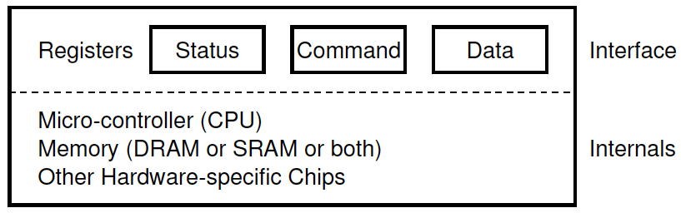
A canonical device (cont’d)
Hardware interface
It allows the system software to control its operation
Three registers:
a status register, which can be read to see the current status of the device;
a command register, to tell the device to perform a certain task;
a data register to pass data to the device, or get data from the device.
By reading and writing these registers, the OS can control device behavior.

Slide 11
A canonical device (cont’d)
Internal structure
It is implementation specific and is responsible for implementing the abstraction (interface) the device presents to the system.
Firmware (i.e., software within a hardware device)

Slide 12
A canonical protocol (output)
Host
OS
Device
While (STATUS == BUSY) {;} (wait until device is not busy - polling)
Write data to DATA register (e.g., multiple writes need to take place to transfer a disk block to the device)
Write command to COMMAND register (lets the device know that both the data is present and that it should begin working on the command)
While (STATUS == BUSY) {;} (wait until device is done with your request - polling)

Slide 13
A canonical protocol (input)
Host
OS
Device
While (STATUS == BUSY) {;} (wait until device is not busy - polling)
Write command to COMMAND register (lets the device know that it should begin working on the command)
Read data from DATA register (transfer a disk block to memory)
While (STATUS == BUSY) {;} (wait until device is done with your request – polling)

Slide 14
Problems in the canonical protocol
Polling seems inefficient.
It wastes a great deal of CPU time just polling the (potentially slow) device, instead of switching to another ready process.
Like the spin lock.
Solution to spin lock
We put the calling thread to sleep for locking.
Wake up the sleep thread for unlocking.
Analogy
Check email constantly, or
Through email notification

Slide 15
Outline
System architecture
I/O protocols
Polling
Interrupts
Notes:
15

Slide 16
Interrupts
No waiting but sleep:
The OS can issue a request, put the calling process to sleep, and context switch to another process.
Notification:
When the device is finally finished with the operation, it will raise a hardware interrupt, causing the CPU to jump into the OS at a predetermined interrupt service routine (ISR) or more simply an interrupt handler.
The handler is just a piece of OS code that will finish the request (for example, by reading data and perhaps an error code from the device) and wake the process waiting for the I/O.

Slide 17
Benefit
Interrupts thus allow for overlap of computation and I/O, which is key for improved utilization.
1: process 1
2: process 2
p: polling
Polling
Interrupt

Slide 18
Interrupts is not always the best solution
Using an interrupt for a fast device will slow down the system:
Switching to another process, handling the interrupt, and switching back to the issuing process is expensive.
It may be best to poll.
There are also cases where a flood of interrupts may overload a system and lead it to livelock:
Find itself only processing interrupts and never allowing a user-level process to run and actually service the requests (like thrashing).

Slide 19
Outline
System architecture
I/O protocols
Polling
Interrupts
DMA
Notes:
19

Slide 20
Direct Memory Access (DMA)
When the main CPU is involved with the data movement, we refer to it as programmed I/O (PIO).
Problem with PIO when transferring a large chunk of data:
The CPU is again overburdened with a rather trivial task.
Waste a lot of time and effort that could better be spent running other processes.
c: initiates the I/O copying the data from memory to the device explicitly, one word (each c) at a time.
PIO
DMA

Slide 21
Outline
System architecture
I/O protocols
Polling
Interrupts
DMA
Other issues
Notes:
21

Slide 22
The crux: how the OS actually communicates with the device?
How should the hardware communicate with a device?
Should there be explicit instructions? Or are there other ways to do it?

Slide 23
Method 1: explicit I/O instructions
They specify a way for the OS to send data to specific device registers.
e.g., on x86, the in and out instructions can be used to communicate with devices.
To send data to a device, the caller specifies a register with the data in it, and a specific port which names the device.
Such instructions are usually privileged.

Slide 24
Method 2: memory-mapped I/O
The hardware makes device registers available as if they were memory locations.
To access a particular register, then, the OS would issue a load (to read) or a store (to write) to that address;
The hardware then routes the load/store to the device instead of main memory.

Slide 25
Fitting into the OS
How to fit devices, each of which have very specific interfaces, into the OS?
How can we keep most of the OS device-neutral, thus hiding the details of device interactions from major OS subsystems?
We’d like to build a file system that worked on top of SCSI disks, IDE disks, USB keychain drives, and so forth;
We’d like the file system to be relatively oblivious to all of the details of how to issue a read or write request to these difference types of drives.

Slide 26
Fitting into the OS: the device driver
Through the age-old technique abstraction.
At the lowest level, a piece of software in the OS must know in detail how a device works.
We call this piece of software a device driver, and any specifics of device interaction are encapsulated within.

Slide 27
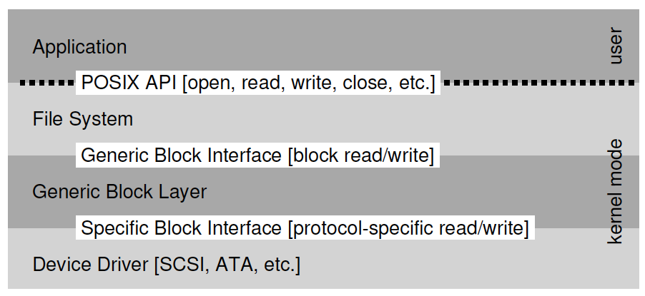
Example of abstraction: Linux file system stack
An application issues block read and write requests to the generic block layer,
which routes them to the appropriate device driver,
which handles the details of issuing the specific request.

Slide 28
Interesting facts
Device drivers represent a huge percentage of kernel code due to many different devices.
Linux kernel: over 70% of OS code is in device drivers.
A modern OS has millions of lines of code.
Actually millions of lines of device-driver code.
For an installation, most of that code may not be active.
Bug in device driver
As drivers are often written by “amateurs”, they tend to have many more bugs and thus are a primary contributor to kernel crashes.

